Slide 1
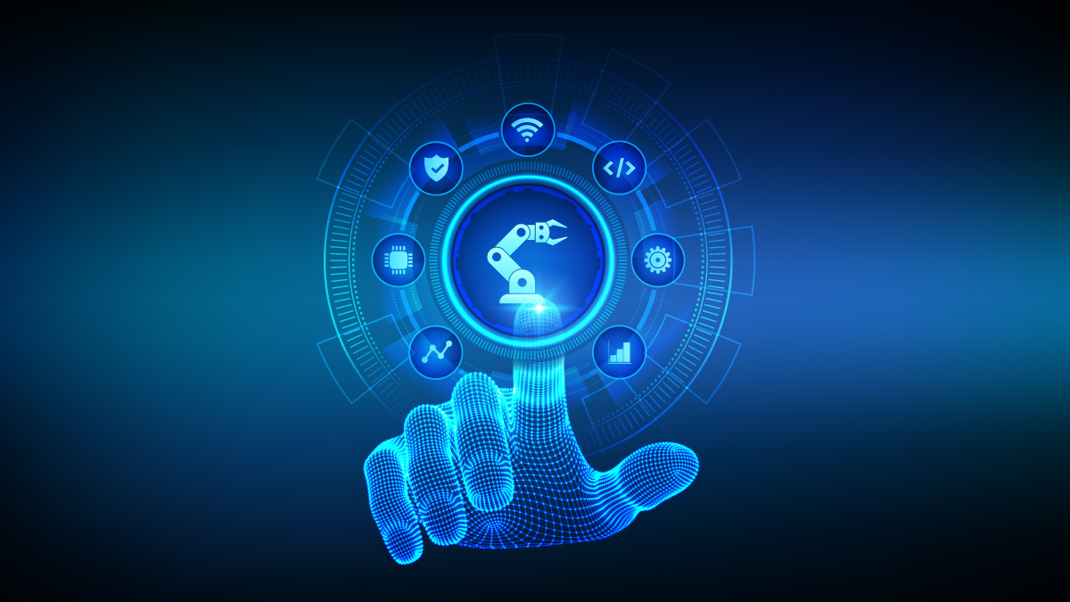
Internet of Things in Industry Revolution 4.0
Image source : OECD Development Matters

Slide 2
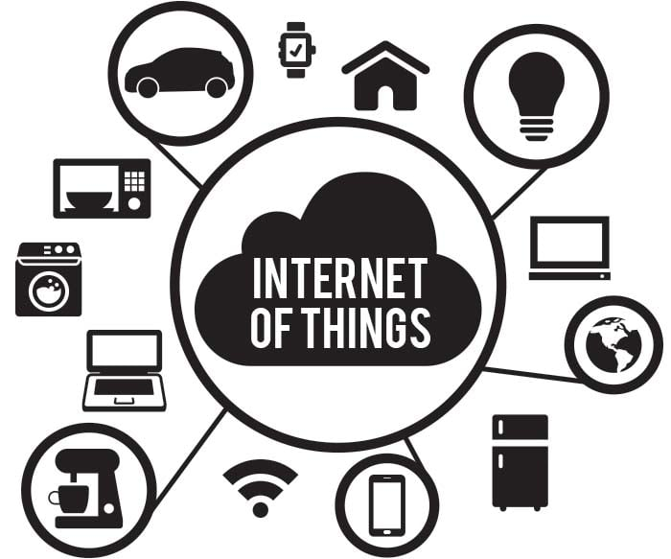
What is the Internet of Things (IoT)?
The network of physical devices
A transformative technology
Everything connected
Image Source: The New Stack

Slide 3
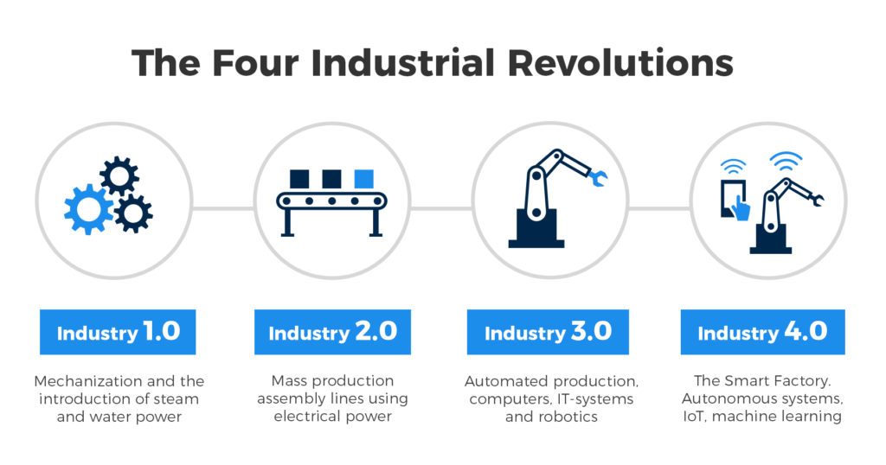
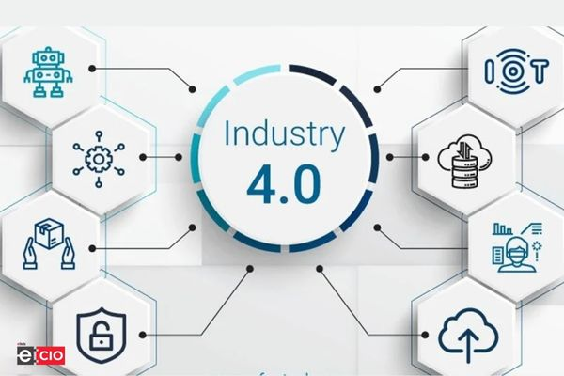
Industry 4.0
The Fourth Industrial Revolution (4IR).
Industry 4.0, includes smart factories as a key element in order to enhance efficiency in part production.
Cyber-Physical and Digitalization of manufacturing.
Use of digital technologies to improve productivity and efficiency.
Image Source: Knowledge Publisher
Image Source: Elets Technomedia

Slide 4
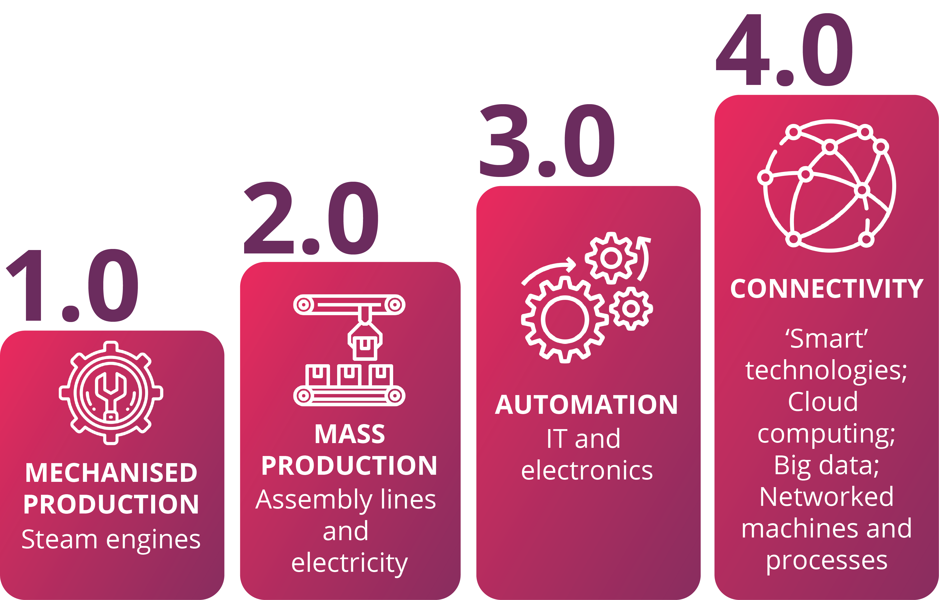
Evolution of industry revolution
Image Source: Manufacturing Solutions that Transforms

Slide 5
Internet of things in industry 4.0 (smart factories) overview
Sensor uses
Software to monitor and optimize the production process
Growth of autonomous systems like transportation and logistics
To monitor and optimize energy usage during part manufacturing
Provide a more comprehensive view of the factory environment to enhance workplace safety

Slide 6
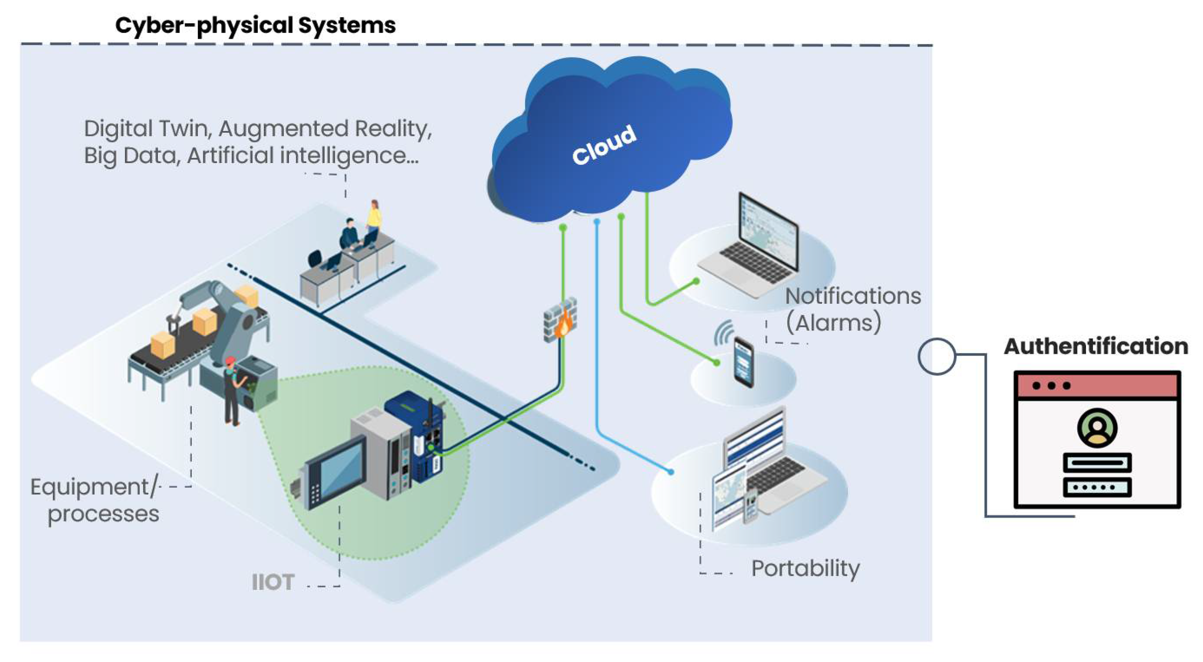
Merits Of IoT in Industry 4.0
Predictive Maintenance
Accurate management of resources
Asset Tracking
Inventory Management
Quality control
Data Driven Decision Making
Image Source: MDPI

Slide 7
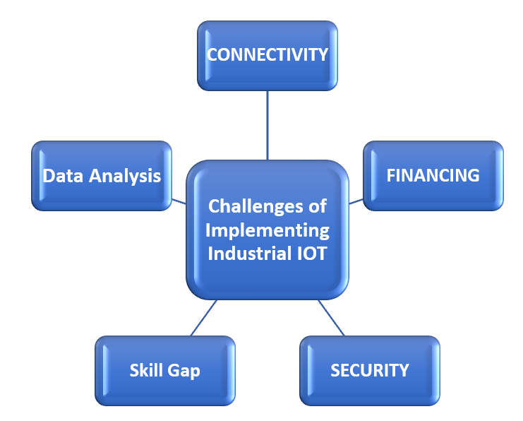
Challenges Of IoT in Industry 4.0
Image Source: Xorlogics

Slide 8
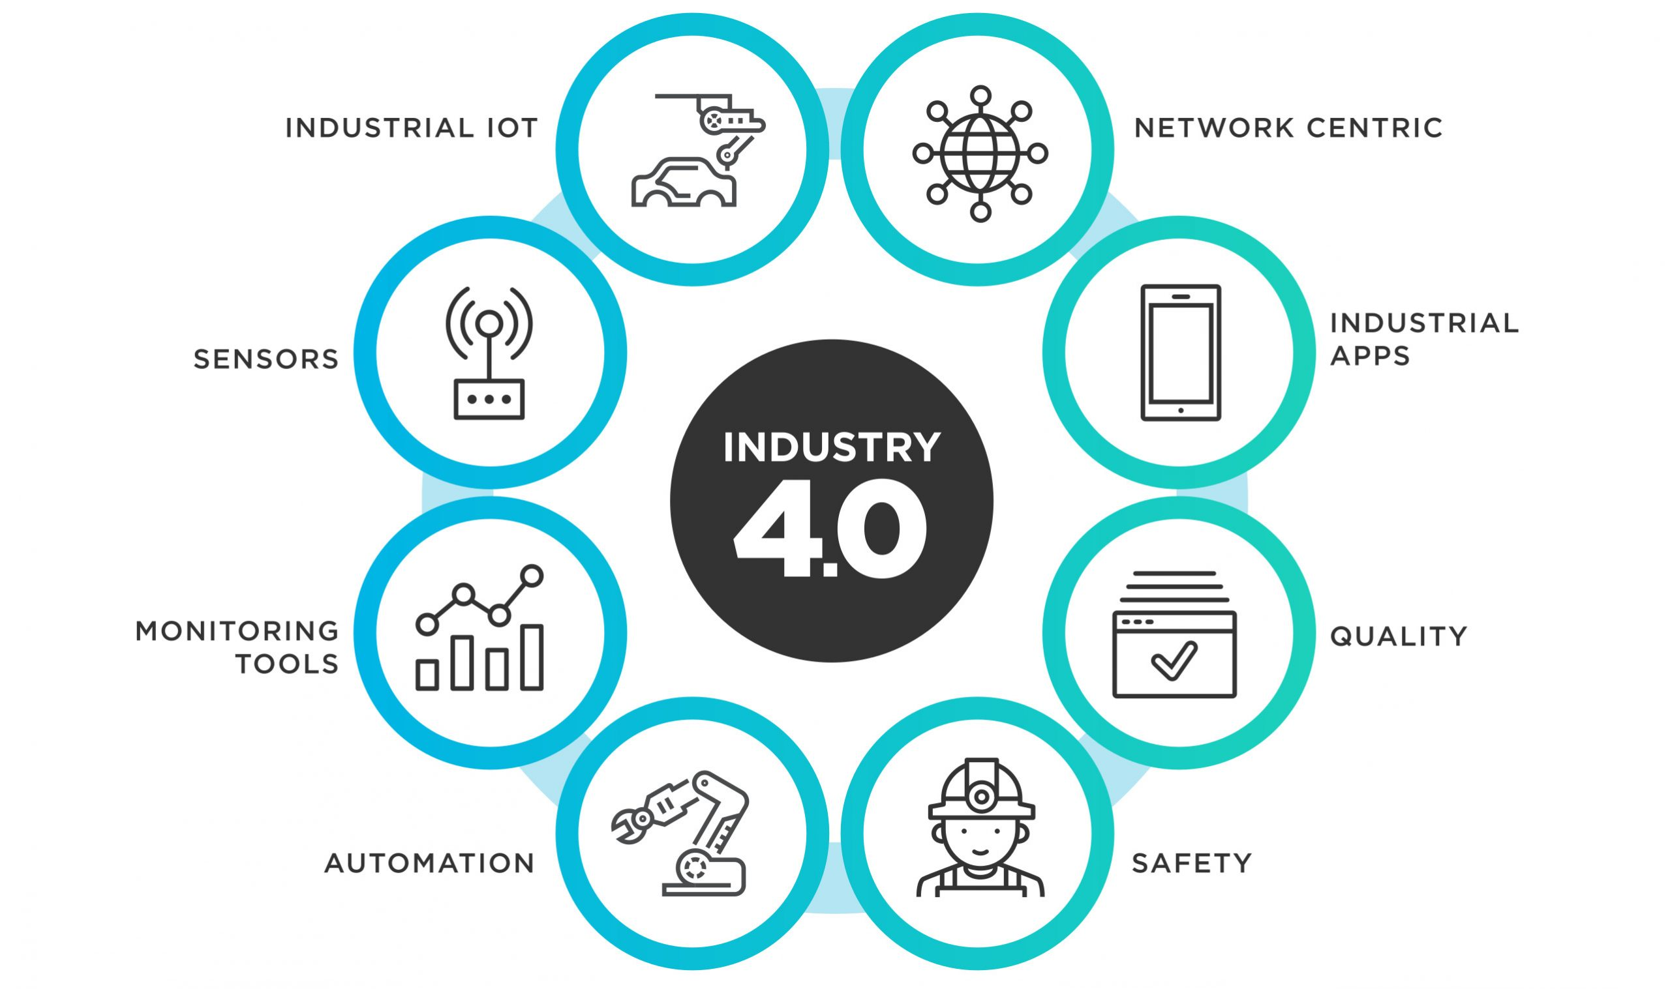
IoT in manufacturing
Image Source: Intelegain

Slide 9
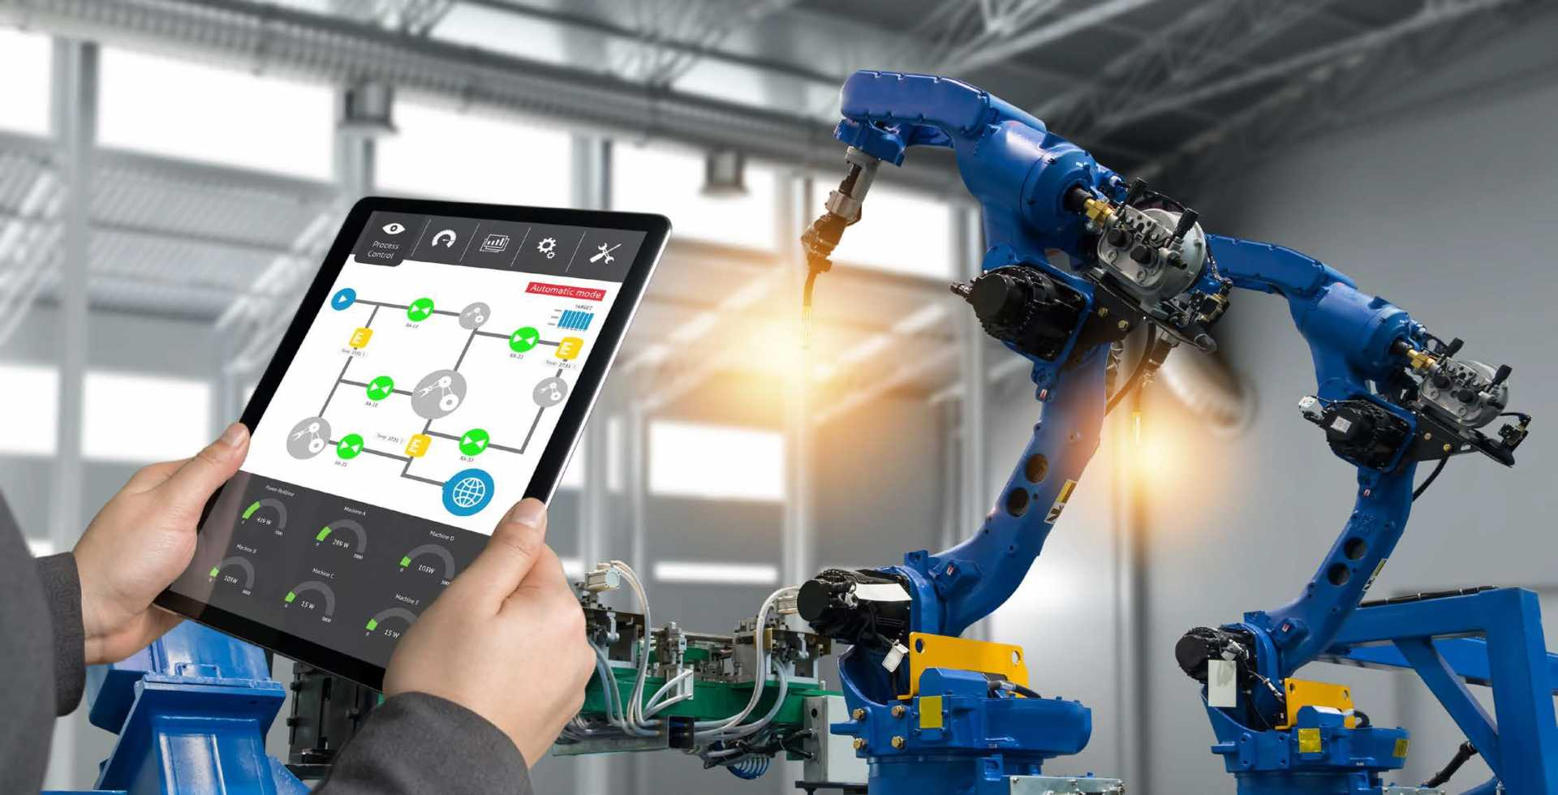
Real World Examples of industry 4.0 or the smart factories implementing iot
Image Source: The Manufacturer

Slide 10
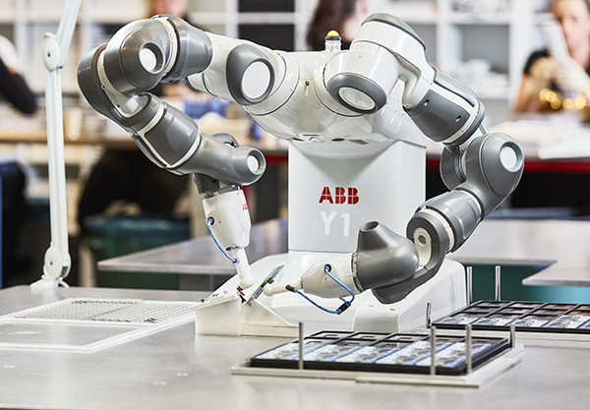
Abb robotics
ABB Robotics is a huge Swiss robotic manufacturing company.
They have been providing the robotics services in both production and budget control during the shortage of skilled labor.
Their main aim is to automate the whole industrial thing.
Image Source: Robotics 4/7

Slide 11
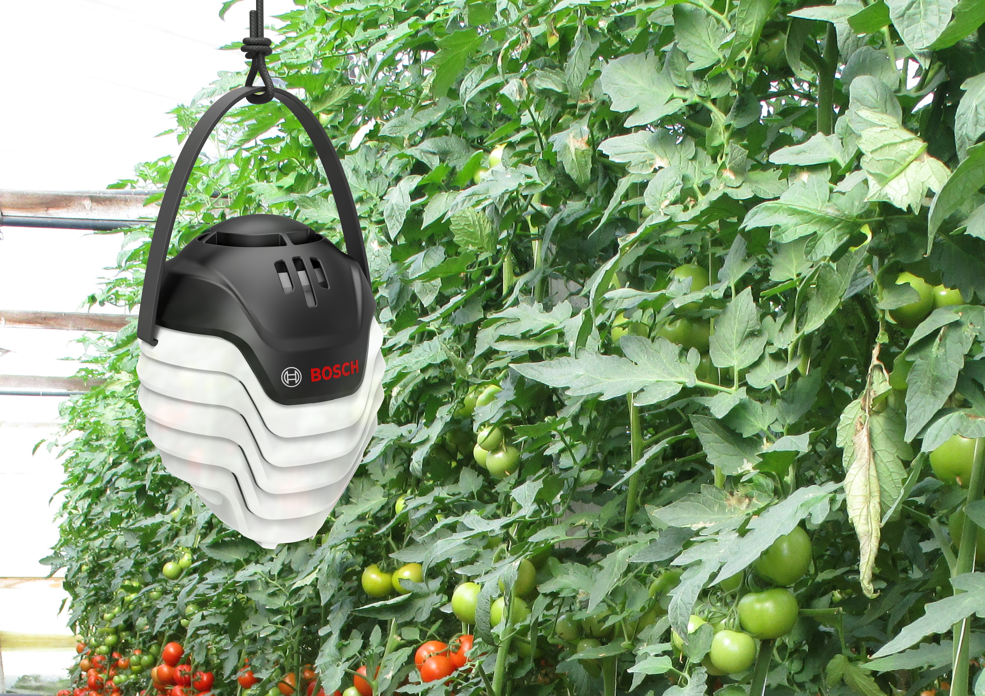
Bosch greenhouse
Bosch’s smart green house uses IoT sensors like thermistors, infrared sensors to detect the temperature, humidity and motion as well.
Bosch company adopted IoT in their greenhouse for the better productivity and predictive maintenance.
Image Source: Bosch Presse

Slide 12
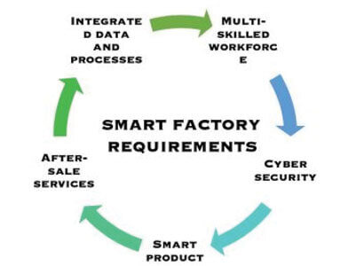
Smart factory components
Image Source: LKH Precicon

Slide 13
Sensors used in Smart factory
There are many IoT sensors used in a smart factory depending upon their compatibility and their use on the particular place.
For instance, sensors like,
Temperature sensor
Infrared sensor
Hall Effect sensor
Proximity sensors, Accelerometers etc.

Slide 14
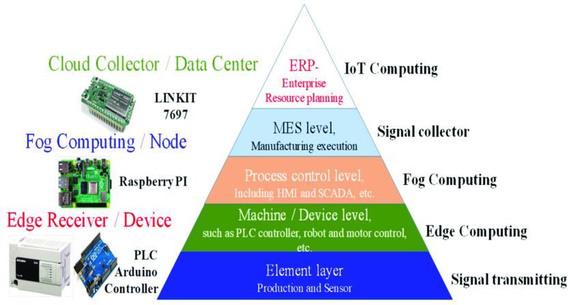
Communication protocol in Smart factory
Image Source: Research Gate

Slide 15
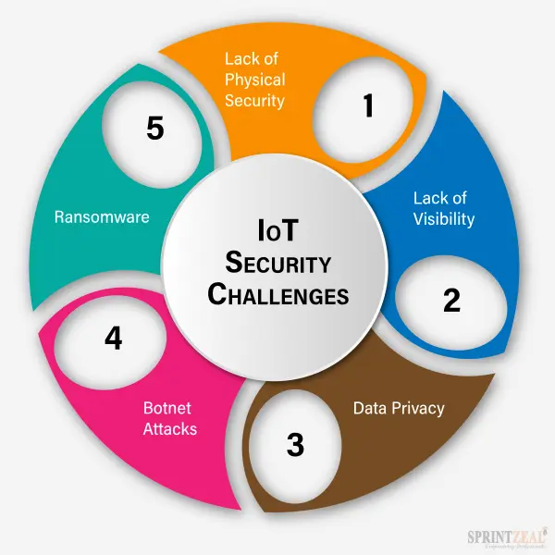
Security challenges
Image Source: Sprintzeal

Slide 16
Human machine collaboration in industry 4.0
Human machine interface
Collaborative robots (cobots)
Skill development
Robots work alongside humans, assisting in tasks, with sensors ensuring safety and adaptability.
VR and AR are used for training, allowing workers to practice tasks in a virtual environment, enhancing skills.
Interfaces like touchscreen, AR/VR enables continuous interaction between human and machine.

Slide 17
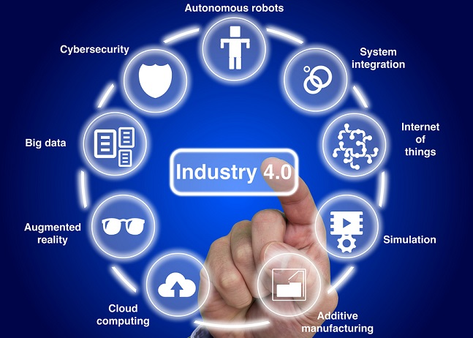
Future of IoT in Industry Revolution 4.0
Increased Integration
Edge Computing
5G Networks
Expanded Applications
Image Source: The Trian Group

Slide 18
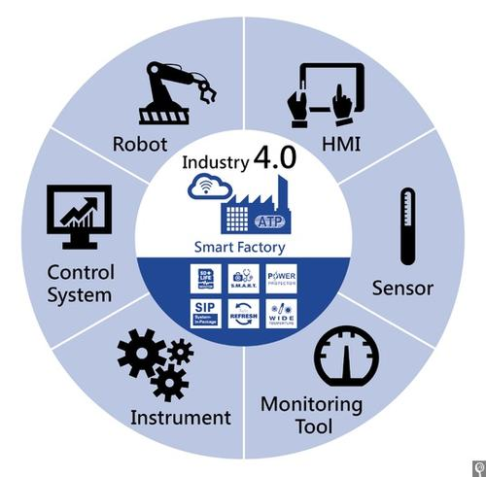
SUMMARY
IoT is Driving Industry Revolution 4.0
By enabling real-time data, insights, and control over complex processes, IoT is transforming the factory floor.
Image Source: IoT Now

Slide 19
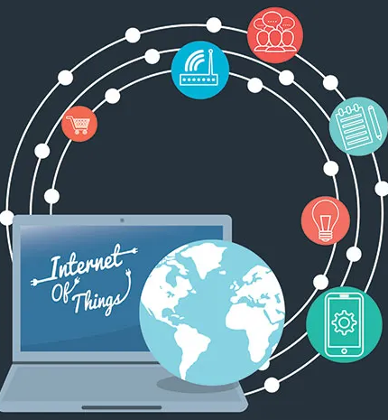
SUMMARY
Security and Interoperability Challenges
Implementing IoT requires overcoming challenges such as security, complexity, and standardization, but the benefits make it worth the investment.
Image Source: Internet of Things Journal

Slide 20

THANK YOU
Presenter name: Ayushma Thapaliya
Level: 05
Module: Internet of Things
Program: BSc(Honorary) Cyber Security and Digital Forensics
Student ID: 22085564

